Slide 1
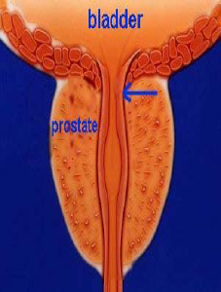
MANAGEMENT OF TURP ON A PATIENT WITH PACEMAKER
Dr. T. Murugan
Prof& HOD, KMC, Chennai
Dr. Ranjan. R. V
Professor, PIMS, Pondicherry

Slide 2
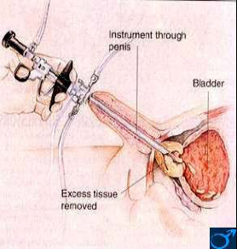
TURP - Introduction
Surgical procedure of choice in men with symptomatic bladder outlet obstruction secondary to benign prostatic hyperplasia.
Resection of Prostate with Diathermy flushed with Irrigation fluid

Slide 3
Applied Anatomy
Nerve supply – Prostatic plexus which originates from hypogastric plexus.
Afferent Pain Fibers originate from S2 , S3 and S4.
Pain impulses from over distended bladder travel with sympathetic fibers that originate from T12 , L1 & L2.
Proprioceptive impulses from the muscular wall of the bladder –by the parasympathetic fibers of S2, S3 & S4.

Slide 4
What are the qualities of an ideal irrigating fluid for TURP?
The ideal irrigant should be:
Iso osmolar and non-haemolytic,
Non-electrolytic,
Non-toxic,
Transparent
Non-metabolizable,
Rapidly excreatable,
Inexpensive.

Slide 5
TURP - Irrigating solutions
Solutions that do not conduct electricity, such as
Sterile water,
Glycine 1.5 % ( 230 mOsm/L)-(Commonly used)
Sorbitol 2.7 %
Mannitol 0.54% ( 195 mOsm/L).

Slide 6
TURP - intraoperative Considerations
TURP Syndrome (2%)
Hemorrhage
Bladder perforation (1%)
Hypothermia
Septicemia (6%)
Disseminated intravascular coagulation
The main challenges are blood loss and TURP Syndrome due to excessive absorption of irrigant fluid.

Slide 7
What are the Indications for permanent pacemaker implantation

Slide 8
1) Acquired AV block
2) After Myocardial infarction
3) Bifascicular or Trifascicular block:
4) Sinus node dysfunction
5) Hypertensive carotid sinus and neurocardiac syndromes

Slide 9
What are the PACEMAKER NOMENCLATURE?

Slide 10
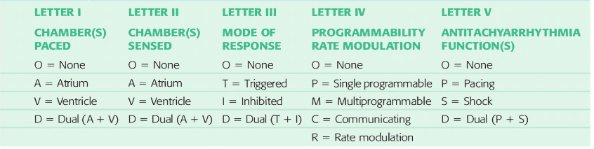
The North American Pacing and Electrophysiology/British Pacing and
Electrophysiology Group (NASPE/BPEG) pacemaker codes

Slide 11
What is ELECTROMAGNETIC INTERFERENCE?

Slide 12
Electromagnetic interference
Electromagnetic interference (EMI) is the potential disruption of the operation of an electronic device when it is in the vicinity of an electromagnetic field generated by an external source like surgical cautery
The effects of cautery on CIEDs differ depending on whether the ECU used is monopolar or bipolar
Current flow is localized between the two poles of the bipolar cautery instrument and usually not associated with problems

Slide 13
Electromagnetic interference
When mono polar cautery is used, the current flow is not restricted and spreads throughout the body
Radio frequency waves with frequencies between 0 and 109 Hz (e.g. AC power supplies and electro cautery) and microwaves with frequencies between 109 and 1011 Hz (including ultra high frequency radio waves and radar) can cause device interference
Higher frequency waves such as X-rays, gamma rays and infrared and ultraviolet light do not cause interference

Slide 14
What are the potential responses of pacemakers to electro cautery?

Slide 15
Responses of pacemakers to electro cautery
Inhibition of pacing
Asynchronous pacing
Reset to backup mode
Myocardial burns (rare)
Ventricular fibrillation (rare)

Slide 16
How would you prevent the effects of EMI on the pacemaker or ICD from the electro cautery?

Slide 17
Prevention the effects of EMI on the pacemaker or ICD from the electro cautery
The safest way to prevent intra operative EMI response is appropriate reprogramming
Place the cautery grounding plate as close to the operative site and as far from the CIED as possible to make sure that the current pathway does not pass through or near the CIED system

Slide 18
Prevention the effects of EMI on the pacemaker or ICD from the electro cautery
Do not use cautery within 15 cm of the pacemaker because it may interfere with the battery circuitry
If in contact with a break in the insulation of the electrode, it may cauterize the myocardium at the electrode tip, rendering it insensitive to pacing impulses
Limit cautery use to 1 -second bursts every 10 seconds to prevent repetitive asystolic periods

Slide 19
Prevention the effects of EMI on the pacemaker or ICD from the electro cautery
If the pacemaker is inhibited by the cautery, place a high-powered magnet over the demand nonprogrammable pacemaker to convert it to fixed-rate mode
Using bipolar electro cautery forceps or ultrasonic (harmonic) scalpel reduces EMI

Slide 20
How do you evaluate these patients Preoperatively?

Slide 21
Pre-operative evaluation
It includes evaluation of the patient and the pacemaker
Since substantial number of these patients suffers from coronary artery disease (50%), hypertension (20%) and diabetes (10%), one should know the severity of the cardiac disease, the current functional status, and medication of the patient
The patient should also be questioned about the initial indication for the pacemaker and pre implantation symptoms such as lightheadedness, dizziness or fainting

Slide 22
Pre-operative evaluation
Pacemaker Evaluation
Determining if the device is functioning properly
DEVICE INTERROGATION

Slide 23
What information would you like to obtain from interrogating this device?

Slide 24
Device interrogation
Device interrogations provide information on the status and current programmed settings of a PPM or ICD
The important primary information for anesthesiologists include
Battery life
Programmed pacing mode such as VVIR, DDDR
Pacemaker dependency
Intrinsic rhythm
Behavior to a magnet
Prior recorded arrhythmic events
Pacemaker lead parameters

Slide 25
TURP - intraoperative Considerations
TURP Syndrome (2%)
Hemorrhage
Bladder perforation (1%)
Hypothermia
Septicemia (6%)
Disseminated intravascular coagulation
The main challenges are blood loss and TURP Syndrome due to excessive absorption of irrigant fluid.

Slide 26
Pathophysiology of TURP syndrome
Intravascular absorption of large volumes of irrigating fluid during the procedure.
The absorption occurs predominantly through exposed venous sinuses of the surgical capsule.
The clinical manifestations brought about by intravascular fluid absorption are referred to as the TURP syndrome
Degree of symptoms depends on the type, magnitude and extent of absorbed fluid.

Slide 27
Patho physiology of TURPS
Increasing volume
Hypervolemia
Left ventricular failure.
Hypertension bradycardia
IV fluid gain
Irrigation absorption
Increased capillary leak
Hypovolemia Hypotension
Cardiovascular collapse
Solute changes
Hyponatremia
Hypo-osmolality
Pulmonary edema
Respiratory failure
Death
decrease
Solute loss
Hemolysis
Acute renal failure
Blood loss
Diuretics
Visual changes seizures
Cerebral edema
Glycine
Encephalopathy
increase
Ammonia

Slide 28
TURP Syndrome - clinical Signs and Symptoms- early Features
Restlessness,
Headache and
Tachypnea.

Slide 29
What is TURP syndrome?- CNS Features
The features of the syndrome include:
CNS: disorientation, restlessness, confusion, agitation, drowsiness, convulsions, coma.
Usually due to water intoxication, dilutional hyponatremia and hypo-osmolality occurs.
Blindness, delayed recovery from anaesthesia, drowsiness may be due to glycine toxicity.

Slide 30
What is TURP syndrome?- CVS & other Features
CVS: volume overload, dyspnea, pulmonary congestion, pulmonary edema, cardiac arrest.
Due to fluid overload and negative inotropic effect of hyponatremia.
Others.
Hypovolemia
Hypothermia

Slide 31
TURP Syndrome - Treatment
Surgery should be terminated
Irrigation fluid should be stopped.
The absorbed water must be eliminated : furosemide 40 mg iv.
Check ABG, serum sodium and HB.
Support respiration with oxygen (face mask) or intubation and ventilation if required.

Slide 32
Hyponatremia
When serum sodium level falls to less than 120 meq /L
Signs of cardiovascular depression can occur.
Less than 115 meq / L causes
Bradycardia,
Widening of the QRS complex,
ST-segment elevation,
Ventricular ectopic beats and T-wave inversion.
A serum sodium level less than 110 meq/L can cause respiratory and cardiac arrest.

Slide 33
Hyponatremia treatment
Estimated sodium deficit = (140 - current serum sodium)x(body weight in kilograms)x(0.6)
Intravenous normal saline
Furosemide (Lasix)
Slow intravenous administration of a 3% hypertonic saline solution, -150-200 ml administered over 1-2 hours.
Accompanied by diuretics (intravenous furosemide).
Hypertonic saline therapy can be repeated as needed.
Carefully monitor electrolytes every 2-4 hours to prevent overcorrection with3% hypertonic saline solution.
Hemodialysis

Slide 34
What can be done to minimize the risk of developing TURP syndrome?
Adequate hydration, electrolyte analysis, and coagulation profile.
Duration of surgery. 1 hour or less. 50ml/min, nearly 3 L of fluid
The hydrostatic pressure created by the fluid irrigating the surgical site must be minimized.
Irrigating fluid flows by gravity, the bag should not hang higher than 60 cm above the operative field.
Rule of 60

Slide 35
Limit the extent of bladder distention created by the irrigant.
-Frequent drainage of the bladder
-Careful surgical resection minimizes exposure of the venous sinuses and preserves the Capsule of the prostate.
Irrigating fluid should be warmed to body temperature
-Blood pressure must be stable.
A decrease in pressure lowers the periprostatic venous pressure and allows increased absorption of fluid.

Slide 36
TURP - Blood Loss
Blood loss is difficult to quantify
Tachycardia and hypotension) may be overshadowed by overhydration due to irrigant absorption and effects of the spinal anaesthesia.
Check HB with a bedside device (haemacue) is useful.
Blood loss -size and weight of prostate tissue excised (normally 15-60 g), the duration of the resection, and the expertise of the operator
Blood loss- 7-20 ml per gram of resected tissue.
Infection will cause increased bleeding.
Blood loss (ml) = Hb of irrigating fluid (gm/ml) x Amount of irrigating fluid/ Patient's Hb (gm/lit)

Slide 37
TURP - Coagulopathy
Dissiminated intravascular coagulation (DIC)-responsible for severe postoperative bleeding after TURP. -Release of thromboplastins from the prostate
Coagulation profiles of DIC are - low platelets, decreased concentration of fibrinogen, factor V and VIII and high titre of fibrin degradation products.
Treatment of DIC includes administration of FFP, clotting factors, platelets and blood if necessary.
Local release of fibrinolytic agents (plasminogen,urokinase) causes bleeding from the raw surface of the prostatic gland during and immediately after TURP .

Slide 38
TURP - Bladder Perforation
The incidence -about 1%.
Perforations mostly occurs - by over distention of the bladder with irrigation fluid.
Can be difficult to recognize in the presence of a spinal block (may mask abdominal pain).
Perforation extraperitoneal - pain inguinal, periumbilical and maximal suprapubic).
Perforation intraperitoneal - generalized abdominal pain, shoulder tip pain
Small perforations are treated by urethral catheter drainage and antibiotic cover.
Major perforations are treated by suprapubic cystotomy or formal exploration, repair of the perforation, drainage of the perivesical space.

Slide 39
TURP - transient Bacteremia and Septicemia
In 6 to 7% of patients septicemia occur(Chills,fever, tachycardia).
In severe cases a septic-shock develops with mortality rates between 25 to 75%.
In recent years sepsis was the most common cause of death after TURP (American urological association cooperative study from 1989).

Slide 40
TURP - Hypothermia
Elderly patients have a reduced thermoregulatory capacity.
Appropriate measures to reduce heat loss are:
warming blankets (bear hugger),
heated irrigating solution and
warm intravenous fluids.
Postoperative shivering associated with hypothermia can dislodge clots and promote postoperative bleeding.

Slide 41
Glycine Toxicity
Absorption of the glycine in the irrigation fluid.
Glycine - acts as an inhibitory neurotransmitter.
When absorbed in large amounts direct toxic effects on heart and retina.
Hyperglycinemia may cause transient visual disturbance (blindess) during TURP .
Glycine may also cause encephalopathy and seizures
In some patients excessive absorption of glycine leads to hyperammonemia (>500 mmol/L)
Nauseated and comatose. (For 10 -12 hours).
They awake when ammonia blood level < 150 mmol/l.

Slide 42
RA Vs GA
Regional anesthesia
awake patient
Signs will be detected earlier
General anesthesia
only clue may be tachycardia and hypertension.
Diagnosis can be confirmed by finding a low serum sodium.

Slide 43
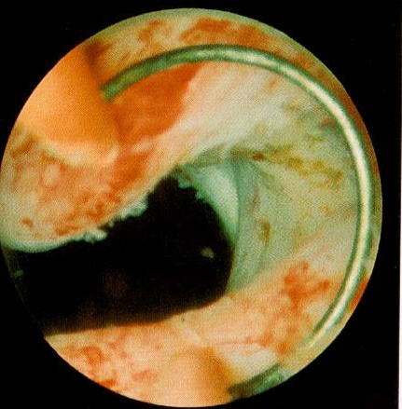
Regional anesthesia is generally preferred
Ability to converse with the patient .
To evaluate him for symptoms of an early dilutional hyponatremia (ie, TURP syndrome) during surgery.
Recovery a little easier

Slide 44
How do you manage these patients intra operatively with respect to pace makers?

Slide 45
Intra-operative management
It is essential that the patient has continuous ECG and pulse oximetry monitoring and arterial pressure monitoring if indicated to give a beat‑to‑beat display and for correlation with artefacts and electrical interference.
The ECG monitor should be kept in diagnostic mode instead of monitoring mode because the former has got wider frequency response range (0.05-100 Hz) which enables assessment of QRS morphology and more accurate ST segment analysis
Temperature monitoring

Slide 46
Intra-operative management
Use of a bipolar cautery is preferred
It is essential to have equipment for urgent transcutaneous pacing, defibrillation and cardioversion

Slide 47
Intra-operative management
The transcutaneous spacing or defibrillator pads must not be placed directly over the CIED. In a majority of the patients, the CIED is left sided, and the transcutaneous pacing or defibrillator pads can be positioned in an anteroposterior fashion
During insertion of a central venous line, the anti‑tachyarrhythmia function must be suspended and asynchronous mode must be initiated

Slide 48
What are the impact of Anaesthetic drugs or techniques on PPM function?

Slide 49
Impact of Anaesthetic drugs or techniques on PPM function
There is no evidence that anaesthetic drugs alter the stimulation threshold of artificial cardiac pacemakers
But it is advisable not to use nitrous oxide in a patient with newly implanted pacemaker as it causes an expansion of gas in the pocket, which leads to loss of anodal contact and pacing system malfunction

Slide 50
Impact of anaesthetic drugs or techniques on PPM function
Factors which may alter the threshold of cardiac pacemakers:
Hyperkalemia
Hypokalemia
Arterial hypoxemia
Myocardial Infarction
Catecholamines
Should be avoided/ prevented

Slide 51
Impact of anaesthetic drugs or techniques on PPM function
Succinylcholine could interfere with the stimulation threshold of PPM because:
It could increase in stimulation threshold due to acute increase in serum potassium concentration
Contraction of skeletal muscle groups (myopotentials) could inhibit the pacemaker
Clinical experience however suggests that suxamethonium is usually a safe drug in the patient with a pacemaker or ICD despite inhibition of PPM function, as the effect is transient

Slide 52
What specific precaution do you take during postoperative period?

Slide 53
Specific precautions during postoperative period
Cardiac rate and rhythm should be continuously monitored throughout the immediate postoperative period
Back-up pacing capability and cardioversion-defibrillation equipment should be immediately available at all times
Postoperative interrogation and restoration of PPM function is an essential part of postoperative management; this usually requires a pacemaker technician
For an ICD, all anti-tachyarrhythmic therapies should be restored
Monitoring signs and Symptoms of TURP syndrome

Slide 54
TURP - Summary
TURP is a common operation performed in an elderly population with many co-morbidities.
7% sustain major complications and about 1% die perioperatively.
Main challenges are blood loss and TURP - syndrome due to excessive absorption of irrigation solution.
Regional anesthesia is the technique of choice-early signs of TURP- syndrome and bladder perforation.
Efficient intraoperative anaesthetic Monitoring, Careful surgery, Meticulous postoperative monitoring
we do not encounter TURP syndrome.
Pacemakers needs extra special care in these patients

Slide 55
PREPP-KMC-XIV
Date
28/03/2020& 29/03/2020
Hotel Savera
PRactical Exam Preparatory Program

Slide 56
For Registration
Contact : Dr. T. Murugan 9444330330
Dr. Nanthaprabhu 9790629459
Dr. Solairajan 9789981681
Mail id - prepp.kmc@gmail.com
Register before 10/03/2020
Delegate Fees: Rs 3000

Slide 57
6th August
Workshops
7th August
CME
8th & 9th August
Conference proceedings

Slide 58
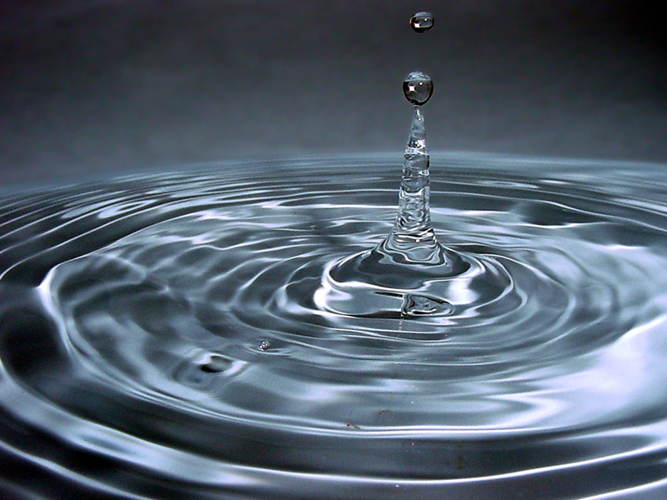
Thank you

